Slide 1
Lab 2 and 3

Slide 2
Questions from past lectures?

Slide 3
Random variables
What is a random variable?

Slide 4
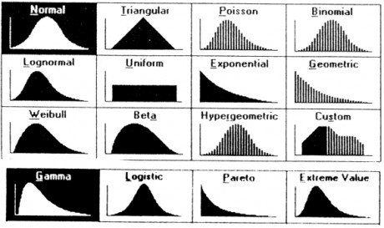
Image taken from: http://tuningsynesthesia.com/en/system/stochastic/

Slide 5
Cumulative probability distribution

Slide 6
Cumulative probability distribution

Slide 7
Cumulative probability distribution

Slide 8
Cumulative probability distribution

Slide 9
Cumulative probability distribution

Slide 10
Cumulative probability distribution

Slide 11
Cumulative probability distribution

Slide 12

PDF properties
$\int_{−∞}^{∞}{f\left(x\right)dx=1}$
Probability between 0 and 1
$f(x)≥0$
Notes:
Animate and ask reason for every property

Slide 13
Normal distribution
Lifespan of some items like bulbs
Measurement errors
IQ

Slide 14
Binomial distribution
Number of patients responding to a treatment
Number of heads/tails in coin toss
Number of people answering “yes” to a survey question

Slide 15
Poisson distribution
Hourly number of people entering a store
Daily number of times a web page is accessed
Number of calls per hour to an emergency number

Slide 16
Extra exercise
Download dataset: Chapter 3
Analyze: Table 3-1 from the examples sheet, Ex-85,86 from the exercise sheet.
Comment on normality (fit a normal distribution to the histogram, plot the normal probability plot)
Try fitting other distributions to the histogram. Which is the best fit?
Optional: How to derive the mean and variance of binomial and Poisson distributions?

